Slide 1

Stage 4/Bay 3.5 Saving Piper Perry Course Designer: Somebody
Saving Piper Perry is a 14 round, 70 point comstock medium course. There are 7 USPSA targets. The best two hits per target will score. The start signal is audible.
The Handgun start position is sitting with both wrists handcuffed and palms flat on the table. Handgun unloaded on the table and all magazines to be used on the stage on the table. The PCC start position is sitting with palms flat on the table. PCC unloaded on the table and all magazines to be used on the stage on the table.
On the audible start signal, engage all targets while remaining handcuffed.

Slide 2
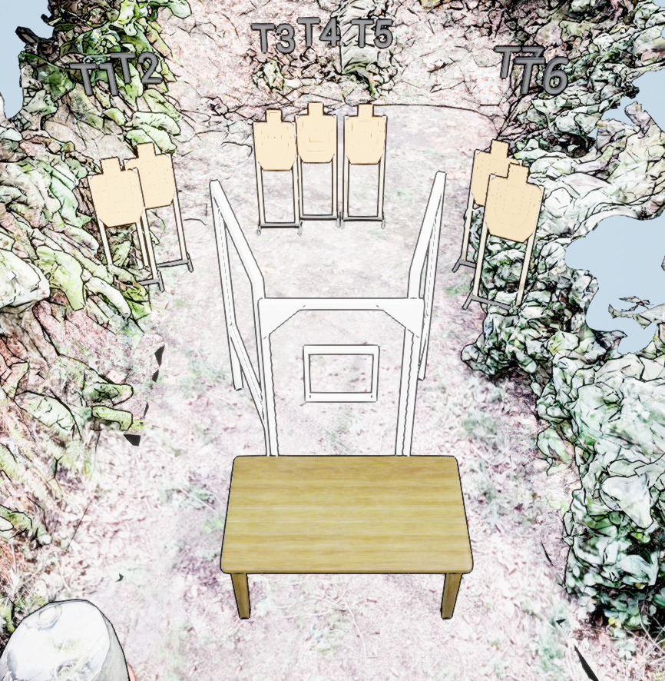
 | Stage 4/Bay 3.5 Saving Piper Perry Course Designer: Somebody

